Slide 1
Recursion and recursive algorithms
By Georgi Stoimenov

Slide 2
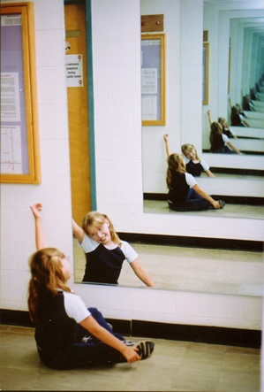
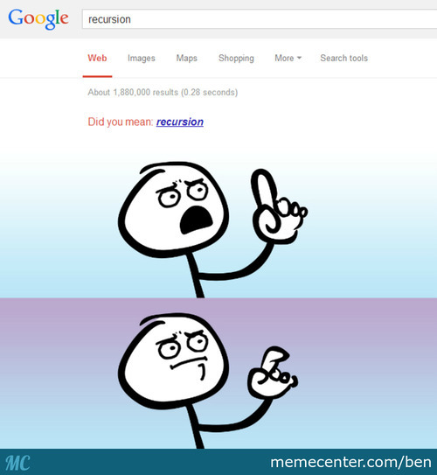
What is actually a recursion?

Slide 3
Recursion in programming is…
“Recursion is a method where the solution to a problem depends on solutions to smaller instances of the same problem (as opposed to iteration)”
Wikipedia

Slide 4

The Fibonacci sequence

Slide 5
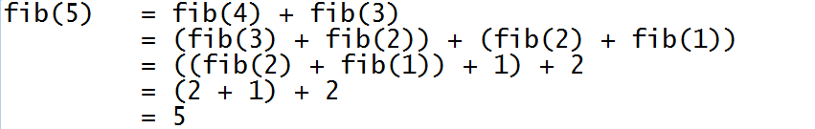
How it works?

Slide 6
Specifics of a recursion
Recursion must have end – it’s called bottom of recursion.
Recursion has depth.
Recursion has two directions(moves) –forward and backward.

Slide 7
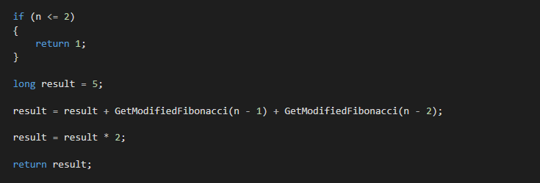
Modified Fibonacci
Bottom
Straight move
Backward move

Slide 8
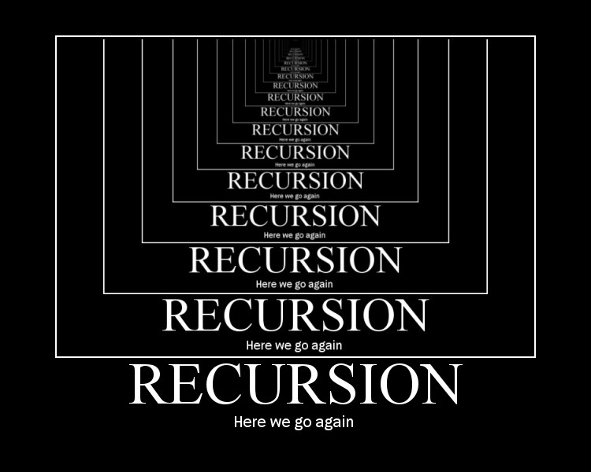
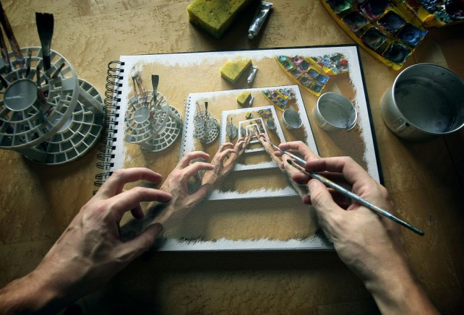
Recursion types
Direct recursion
Indirect recursion
Tail recursion

Slide 9
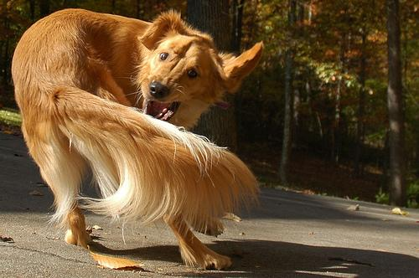
Tail recursion
In tail recursion, you perform your calculations first, and then you execute the recursive call, passing the results of your current step to the next recursive step.

Slide 10
Tail recursion – calculation of Factorial

Slide 11
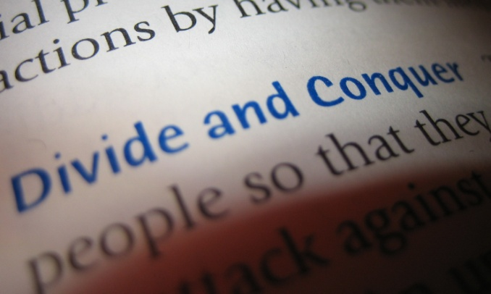
Recursive algorithms
A common computer programming tactic is to divide a problem into sub-problems of the same type as the original, solve those sub-problems, and combine the results.

Slide 12
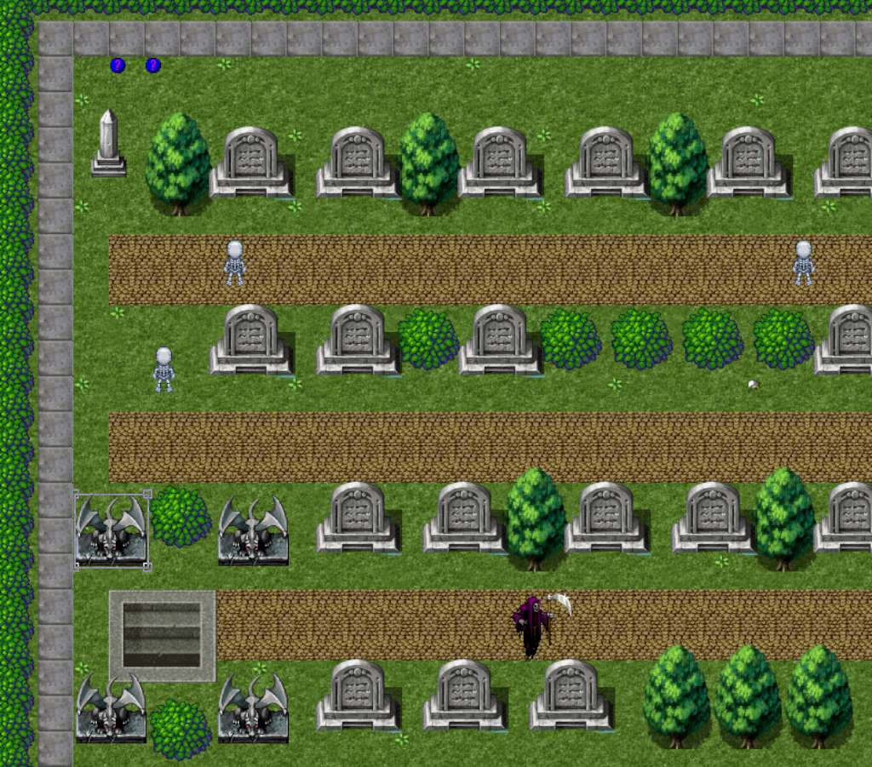
Interesting algorithms with recursion
Find path in labyrinth

Slide 13
Find path in labyrinth

Slide 14
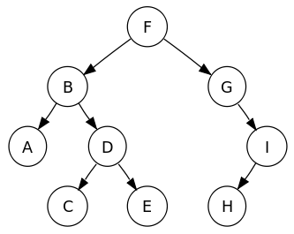
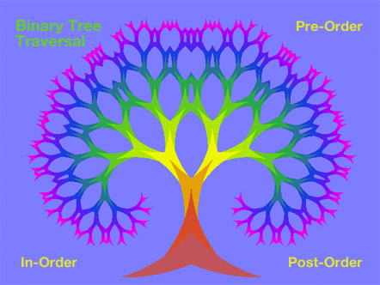
Traversing through tree like data structures
Tree traversal visualization

Slide 15
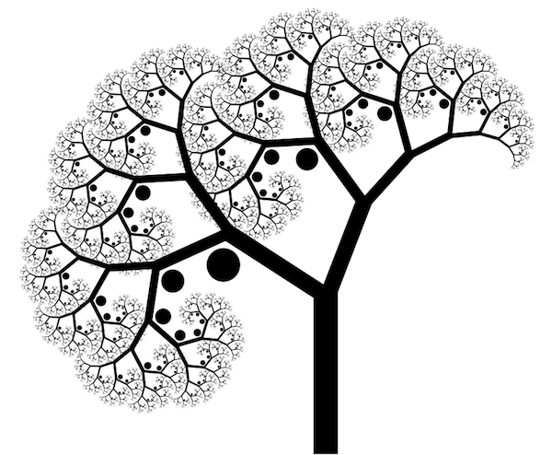
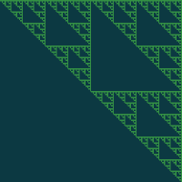
Drawing
Click me!

Slide 16
Drawing a binary tree

Slide 17
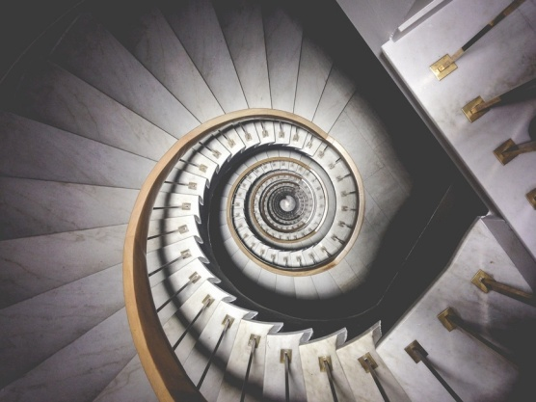
What are the benefits of Recursion?
1. Simpler code
2. Improved code readability
3. Easier approach (sometimes)
4. Can be referred with divide and conquer technique

Slide 18
Is recursion perfect?
When using big data or even bad algorithm
can cause StackOverflow Exception.
May require more memory (because of stack)
It's usually slower due to the overhead of maintaining the stack.

Slide 19

What is the alternative?
Iteration
Works well with big data.
No additional memory used.
Easy calculation of time complexity of the algorithm.

Slide 20


Conclusion
Recursion is really
powerful tool but it can
Turn against it’s user. If
It’s not used correctly
may cause your system
stack to “crack”.

Slide 21


Questions ?

Slide 22
Thanks for the attention!
https://goo.gl/oHlTgs

